Slide 1
Globelics Seminar on Innovation and Economic Development Innovation policy in turbulent times: “let a hundred flowers bloom and a hundred schools of thought contend”
Michael Kahn
Centre for Research on Evaluation, Science and Technology
Stellenbosch University
South Africa
22-23 March, 2012, Kunduchi Beach Hotel, Dar es Salaam

Slide 2
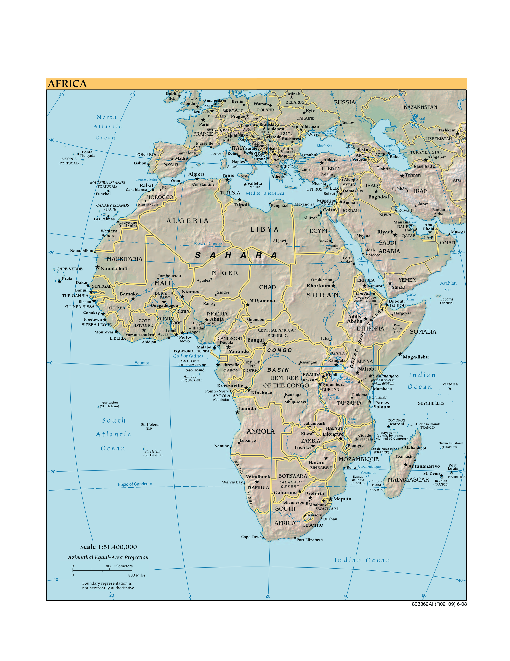
The New Scramble for Africa
EU
RUSSIA
SKILLS
INDIA
USA
CHINA
BRAZIL
SOUTH AFRICA

Slide 3
BRICS, BRIICS, BRIICSTVM?
BRICS – Brazil falls to 2,6% in 2012;
Russia – Gas station of EU; instability
India stuttering reforms;
China growth now below the iconic 8%;
South Africa stuck: growth ±3%; high inequality
African lions: Zim 9,5% Moz from LIC to LMC
Resource Curse: Angola; Mozambique, Tanzania, South Sudan, Gabon, Equatorial Guinea, Uganda, Zimbabwe, South Africa …

Slide 4
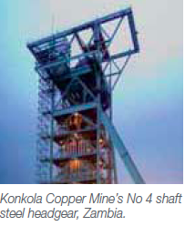
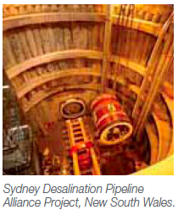
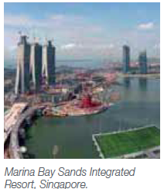

Slide 5
London
Houston
Perth
Cape Town

Slide 6
“STI can only be used as the lever for structural transformation if it is engaged within a planning context designed to alter historically determined structures. This, in turn, can only be done through the recognition of the historical and structural specificities that form the basis of the concept of national systems of innovation” (AIO, 2010: 19)
It’s not that simple …
Lundvall et al (2009: 6) identify no fewer than 7 definitions of IS then offer their own: ‘The NIS is an open, evolving and complex system that encompasses relationships within and between organizations, institutions and socio-economic structures which determine the rate and direction of innovation and competence-building emanating from processes of science-based and experience-based learning.’

Slide 7
Some pointers
… technologies in some industries are close to science, while in others there is little in the way of scientific foundations. In some connections with universities are important, while in others there is little interaction. Patents are important in some industries but not in others. To be effective policies aimed to help industries develop must understand and respect these differences (Rosenberg, 2009).
(The linear) model implies that there should be a link between HERD and BERD (but) there is no credible evidence for this. On the contrary, as in the South African innovation survey, countless surveys of OECD firms show that their main sources of technology are internal knowledge and other firms. Public sector research in general, and higher education research in particular, accounts for a small share of their total knowledge inputs to innovation (OECD, 2008: 186).
We struggle to agree on demand, and even how to specify demand

Slide 8
From the African Innovation Outlook
✔ “The proportion of diversified economies … will have to rise significantly and rapidly to provide the basis for a feasible programme of continental integration” (AIO, 2010: 20)
✔ “The attainment of most of the MDGs requires innovation at the technological level; it also requires innovation on the institutional front in education, health and international partnerships” (idem 27).
✔ North Africa and Sub-Saharan Africa are separate and distinct, related to the nature of their colonization and the ensuing post-colonial states.
✗ “Africa does not lack entrepreneurs or individual enterprise. … most of those who behave as entrepreneurs do so because of the lack of alternatives, forced by economic circumstances, political instabilities and general institutional failure” (idem 28).

Slide 9
✗ There is a “congruence of factors which, in the post-colonial period, now render most autonomous national systems of innovation non-viable, there is a need to … transform the region from a set of disparate national systems of innovation into a continental (or at least sub-continental) agglomeration. The first stage of this transformation requires the mobility of people and resources, as well as information across current national borders. Beyond this, however, a sustainable continental system of innovation requires the integration of the particular national legal frameworks in sectors such as finance, labour, industry and the environment” (ibid 29).
AIO is mainly about R&D!

Slide 10
We do the best we can with indicators
Country | Status | GCI | KEI | GERD/ | WoK 2005- | Primary | Secondary
 |  | BS rank | value | GDP | 2009⁺ | NER%⁺⁺ | NER%⁺⁺
Angola | UMC | 139 | 1.7 | n.a. | 107 | 50 | n.a.
Brazil | UMC | 38 | 5.57 | 1.18 | 117 233 | 95 | 82
Ghana | LMC | 100 | 2.5 | 0.38 | 1487 | 76 | 46
Kenya | LMC | 58 | 2.82 | 0.48 | 3866 | 83 | 50
Malaysia | HC | 25 | 6.06 | 0.24 | 12942 | 94 | 68
Moçambique | LMC | 101 | 1.71 | 0.25 | 393 | 92 | 16
Rwanda | LMC | 87 | 1.34 | n.a. | 192 | 96 | n.a.
South Korea | HC | 18 | 7.68 | 3.37 | 154 292 | 99 | 96
South Africa | UMC | 43 | 5.55 | 0.92 | 29 239 | 90 | 65
Tanzania | LMC | 94 | 2.28 | 0.48 | 514 | 98 | 5
Uganda | LMC | 111 | 2.46 | 1.1 | 459 | 92 | 21
Everyone talks agric but forgets about the plant cultivars

Slide 11
Do the comparatives … Korea is salutary

Slide 12
Patents and policy
Korea 343 USPTO patents over 1963 to 1987
South Africa 1744 USPTO patents over 1963 to 1987
Korea 57625 USPTO patents over 1987 to 2008
South Africa 2232 USPTO patents over 1987 to 2008
(NO 3898 USPTO patents over 1987 to 2008)
Ten Year Innovation Plan & New Growth Path aim for 250 USPTO p.a. by 2018. How?
There is no IP in an ingot of gold or a tonne of coal
High tech exports comprise small volume of exports
Our manufacturers seek technology via foreign partners
One patents in the markets where one competes
IP from publicly funded R&D Act

Slide 13
MEASURING R&D IN DEVELOPING COUNTRIES Annex to the Frascati Manual (2012)
http://www.oecd.org/sti/frascatimanual
http://www.oecd.org/sti/frascatimanual#annex

Slide 14
Think differently: high levels of incremental innovation
Source: Innovation Survey 2005

Slide 16
Sources of innovation: re-think the relationships
COLLABORATION
FIRM

Slide 17
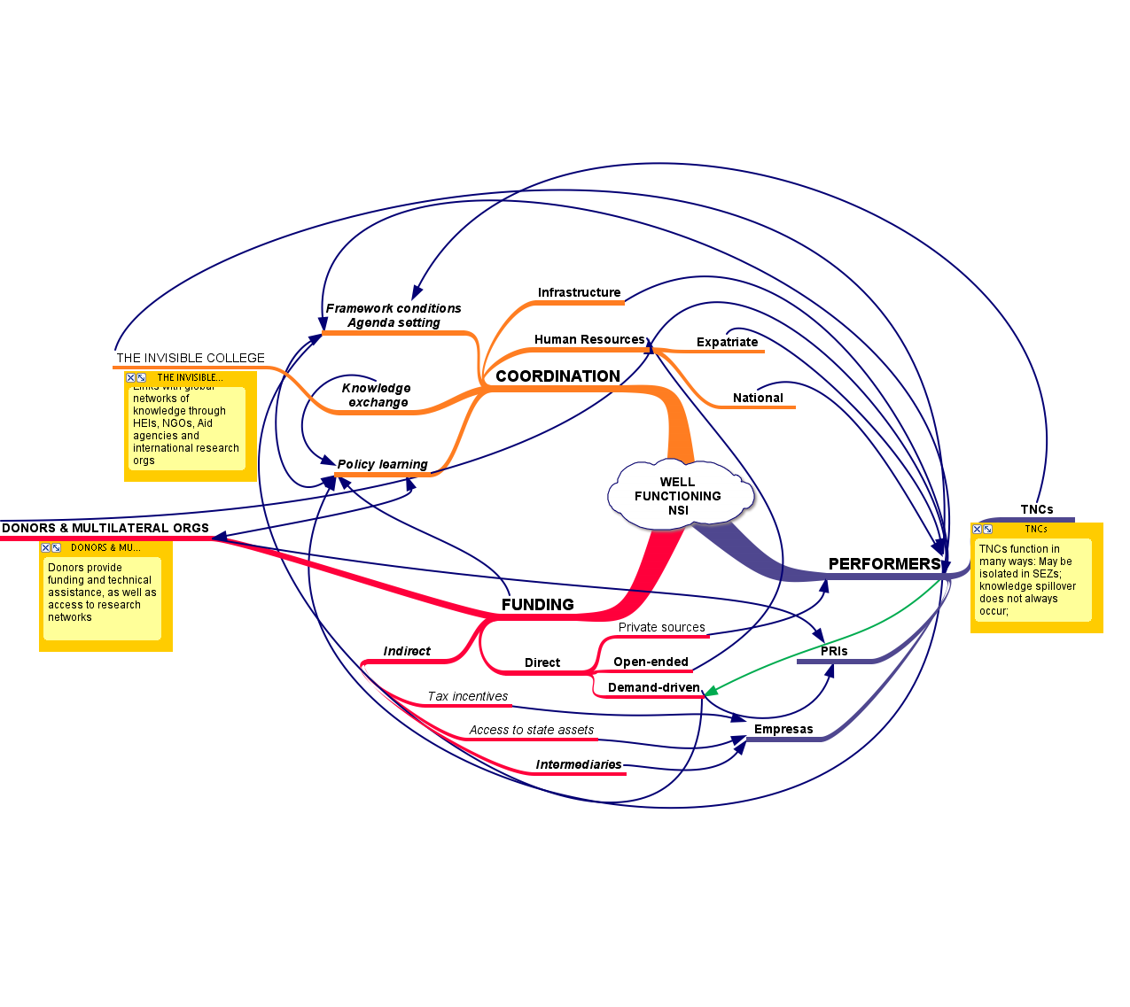
Elements of a well-functioning innovation system

Slide 18
Innovation under turbulence: challenges
Freeman and Soete (2007: 281) : developing countries exhibit “disarticulated knowledge systems akin to Europe in the Middle Ages, where new knowledge remained isolated in pockets with no diffusion to the rest of society..”
Colonial institutional legacy: where to invest? Standards or blue sky
Balance: elite formation vs equity; higher vs basic education; large firms vs SMMEs; technocrats vs liberal arts
Resource nationalism the new reality: Botswana; Brazil; Australia; South Africa – ring fence rents for the future. BT, MZ, TN, MY ….
Rapid resource utilization implies turnkey solutions with high costs of entry; well established supply chains
Agricultural, health, tourism, public sector and ICT innovation beckon; prepare for the Oil and Gas future
The state as innovator – it’s all about “LUC.” Regulation & Innovation
Innovation system architecture vs function. Role of Interests

Slide 19
Managing the opportunity of commodities
Prebisch: Lived through Hobsbawm’s Age of Extremes.
A quant with a heart; theory of inward industrialization for commodity exporting nations coupled with macro-economic stability.
Confront power of the centre over the periphery.
Advocate of an ‘intelligent regime’ combining the market economy with regulatory and policy frameworks of the state.
Made ECLAC the leading centre of economic thought in Latin America; proponent of regional integration; statistics; training.
The disappointment – application in Asia but not in Latin America (to the mid 1970s).
Crisis of poverty; opportunity of resource nationalism

Slide 21
Closing thoughts
Make the hard choices
Build the base: SET (and the social sciences)
Difficult to create technology-based industries in Africa (emerging economies?). What do Carlos Slim, Naguib Sawiris and Mo Ebrahim have in common?
Cape Town is World Design Capital 2014 (www.iscid.org)
2025: The Indian Ocean Naval Accord collapses in conflict over oil and gas fields. The China-India Task force intervenes. The EAC Stock Market soars … Hakuna matata

